Slide 1
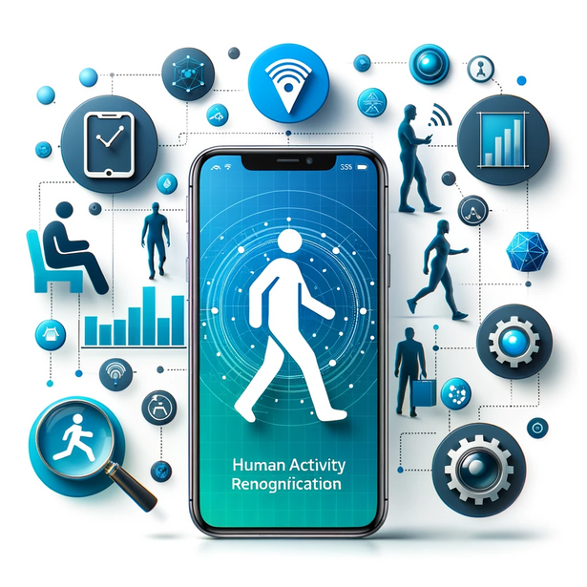
HUMAN ACTIVITY RECOGNITION USING SMARTPHONES
By,
HARIKA MANGU
PRAJWAL SRINIVAS
RAAGA SINDHU
SHRIRAM VIJAYKUMAR
VARUN KUMAR KUMARAVEL
IE 7300

Slide 2
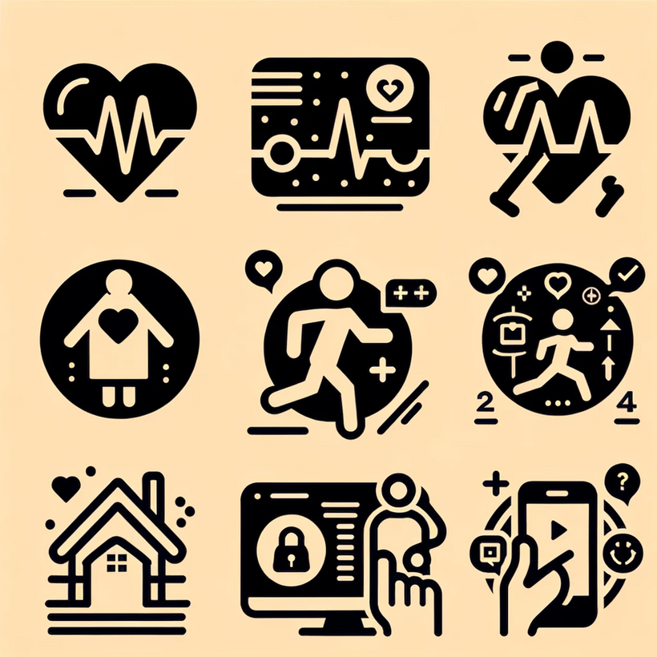
PROJECT OVERVIEW
OBJECTIVE
To develop a machine learning model that accurately classifies human activities such as walking, sitting, and standing, using data from smartphone sensors.
Applications:
Enhancing Health Monitoring
Advanced Fitness and Wellness
Supporting Elderly and Physically Challenged
Enabling Smart Homes and Environments
Driving Innovations in Human-Computer Interaction

Slide 3
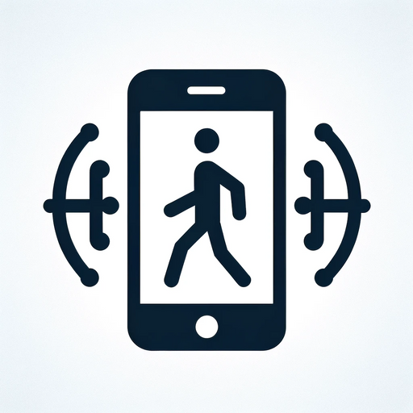
MAIN DATASET
LINK: https://archive.ics.uci.edu/dataset/240/human+activity+recognition+using+smartphones
Consists of approximately 10,299 instances, divided into training and testing sets.
Data collected from a group of 30 volunteers within an age bracket of 19-48 years

Slide 4
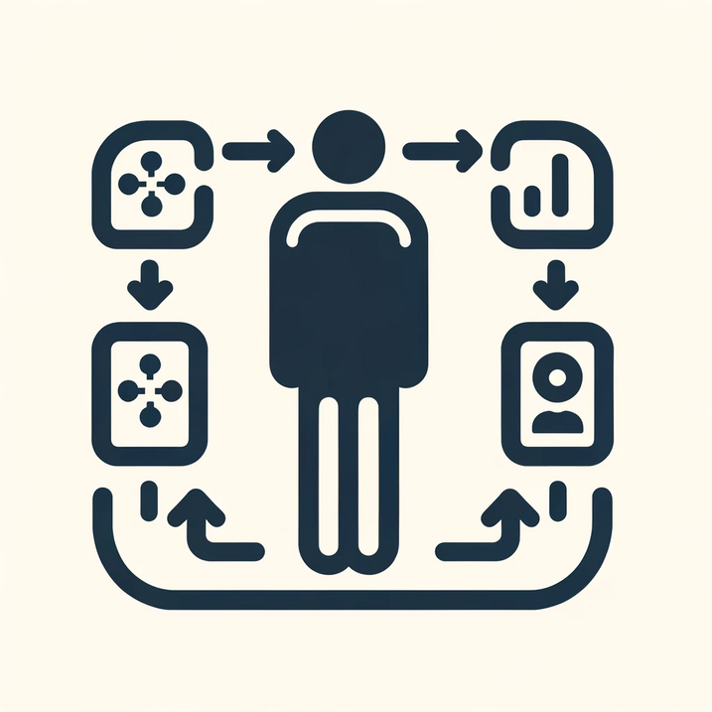
DATA PROCESSING STEPS
Data loading:
Loaded sensor data from text files using pandas
Missing value check:
Verified no missing values in the dataset
Activity distribution visualization:
Used barplots to visualize the frequency of each activity
Label encoding:
Transformed activity labels into numerical format
Feature standardization:
Normalized sensor data features using standardscaler
Dimensionality reduction:
Applied pca to reduce feature dimensions, maintaining 95% variance
Preprocesses data summary:
Reviewed final dataset structure and basic statistics

Slide 5
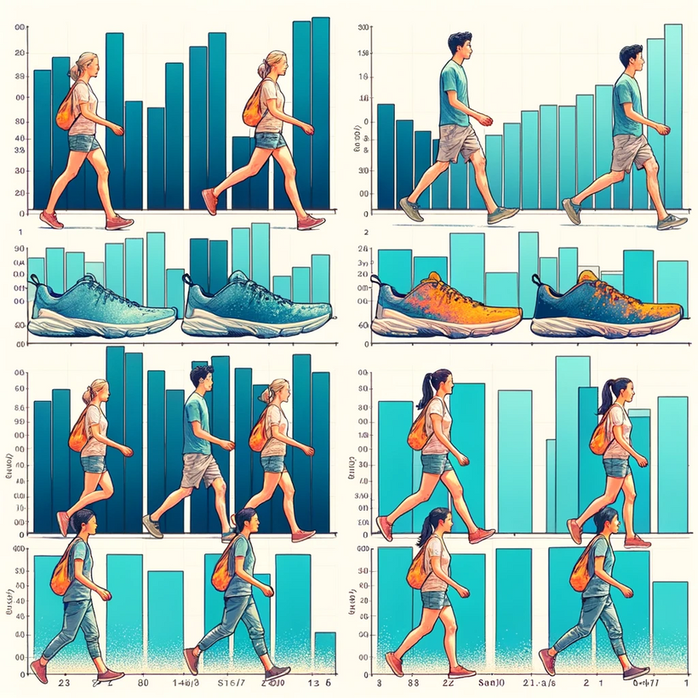
EXPLORATORY DATA ANALYSIS
ACTIVITY DISTRIBUTION IN TRAINING DATA:
Visualized with a bar plot to show the frequency of each activity type.
ACTIVITY DISTRIBUTION IN TESTING DATA:
Similar bar plot analysis conducted for the test dataset.

Slide 6
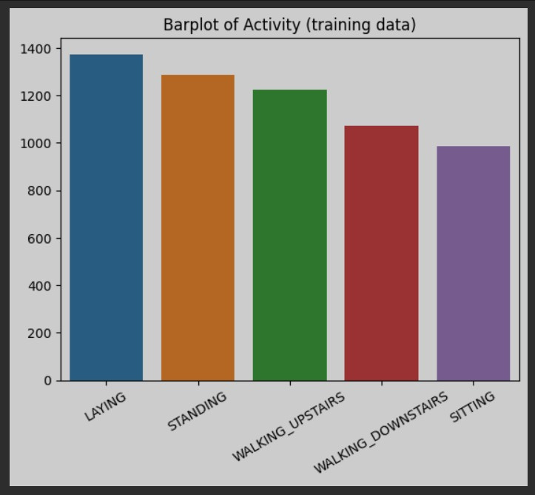
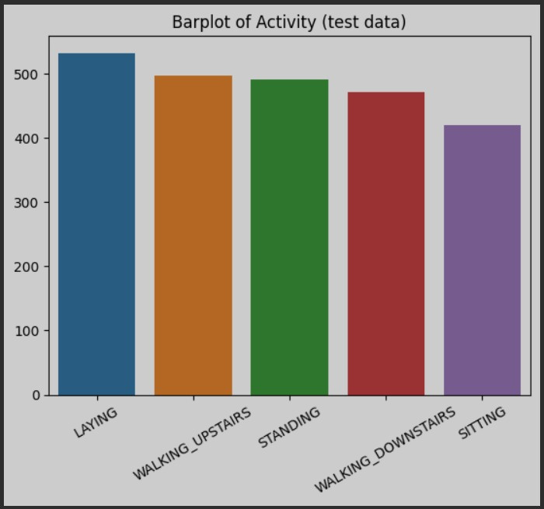

Slide 7

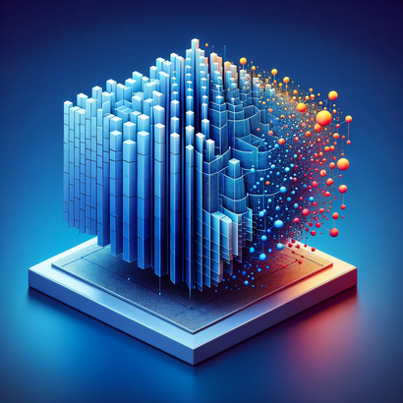
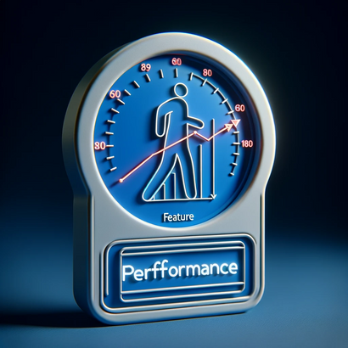
FEATURE ENGINEERING
SELECTING RELEVANT FEATURES
PCA FOR DIMENSIONALITY REDUCTION
IMPACT ON MODEL PERFORMANCE
The relevant features for activity recognition are implicitly selected through the PCA process.
PCA is applied to trainsform and reduce the feature space. This helps in focusing on the most significant aspects of the sensor data, simplifying the model and potentially enhancing performance.
The application of PCA in feature engineering aims to improve model accuracy and generalization by reducing data complexity and focusing on essential features.

Slide 8
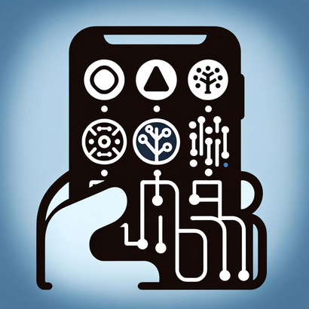
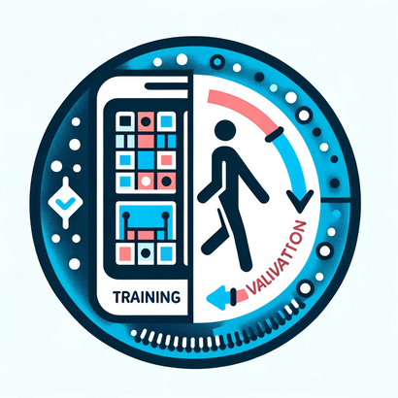

MODEL SELECTION AND TRAINING
MODEL SELECTION
TRAINING AND VALIDATION PROCESS
HYPERPARAMETER TUNING TECHNIQUES
Tested Machine Learning algorithms include Gaussian Naive Bayes and Softmax Regression. Additionally, Neural network model was implemented using TensorFlow and Keras, designed for multi-class classification.
Data split into training and test sets, with PCA applied for dimensionality reduction. Used StandardScaler for feature normalization, ensuring data is suitable for model training.
Neural Network model trained with specific hyperparameters: number of layers, neurons, dropout rate, and learning parameters. Iterative process to adjust and optimize these parameters for best model performance.

Slide 9



MODEL EVALUATION AND COMPARISON
GAUSSIAN NAIVE BAYES
SOFTMAX REGRESSION
NEURAL NETWORKS
Applied based on the assumption of independence among features, which simplifies computation. Partculary effective when dealing with high dimensional data like sensor readings.
Implemented as a multi-classification model, extending logistic regression for handling multiple class.
Utilized a deep learning approach with multiple layers to capture complex patterns in sensor data.

Slide 10
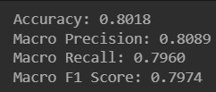
GAUSSIAN NAIVE BAYES
The model accurately predicted the correct activity 80.18%
of the time, indicating a high level of overall correctness in classification.
On average, 80.89% of the predictions made for each activity class were correct.
The model successfully identified 79.60% of all relevant instances across various activities.
With an F1 score near 0.8, the model demonstrates a balanced performance between precision and recall.

Slide 11

SOFTMAX REGRESSION
The model achieved a high accuracy rate of 94.26%, effectively distinguishing between different activity types.
Demonstrated a commendable level of 94.24% precision, which signifies the model’s ability to minimize false positives across different classes of activities.
Exhibited a strong recall score of 94.21%, indicating its effectiveness in capturing a high proportion of actual positive instance for each activity type.
The balanced F1 score of 94.22% reflects a well-maintained equilibrium between precision and recall.

Slide 12
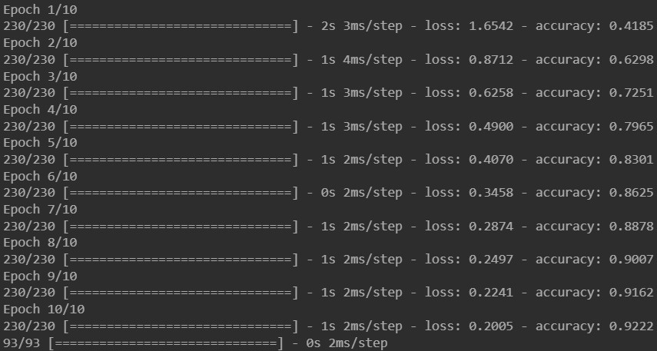
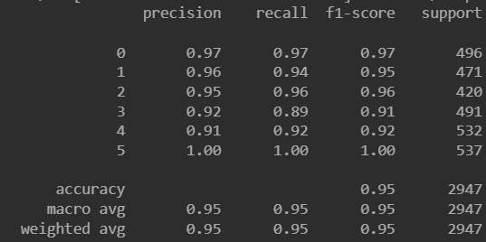
NEURAL NETWORKS
Accuracy over Epochs:
Each epoch shows the model’s improving accuracy, indicating effective learning over iterations.
Loss over Epochs:
Depicts the decrease in loss with each epoch, signifying the model’s increasing proficiency in activity classification.
Details the model’s precision, recall, F-1 score, and Support for each activity class.
Macro-average: Reflects the overall accuracy across all classes, giving equal weight to each.
Weighted average: Presents accuracy accounting for the imbalance in the dataset.

Slide 13

NEURAL NETWORKS: OUR BEST PERFORMER
Neural Networks outperformed other models in accuracy, precision, recall, and F1-score metrics.
Ability to learn non-linear relationships in the data.
One innovative real-world application is the potential to significantly enhance user experience in health and fitness apps by delivering accurate activity data.

Slide 14

CONCLUSION
Successfully developed and evaluated machine learning models, particularly Neural Networks, for human activity recognition using smart phone sensor data.
Achieving high accuracy and robustness in activity classification, surpassing other models like Gaussian Naive Bayes and Softmax Regression.

Slide 15

FUTURE WORK
Incorporate other types of sensor data, such as heart rate, GPS, to enrich the activity recognition process.
Extend the application of the model to broader contexts, such as elderly care, sports science, and physical therapy.
Instigate the use of more complex neural network architectures, like Convolutional Neural Networks (CNNs) , for enhanced accuracy and efficiency,

Slide 16
THANK YOU

